Slide 2
New Zealand
Chapter Five
Learning Goals
To understand the geographical position, climate, language, economy, politics, religion, and education in New Zealand.
To learn the people and culture of New Zealand.

Slide 3
New Zealand
Chapter Five
Section A
Exploring the World
Section B
Broadening My Horizon
Section C
Reading for Pleasure

Slide 4
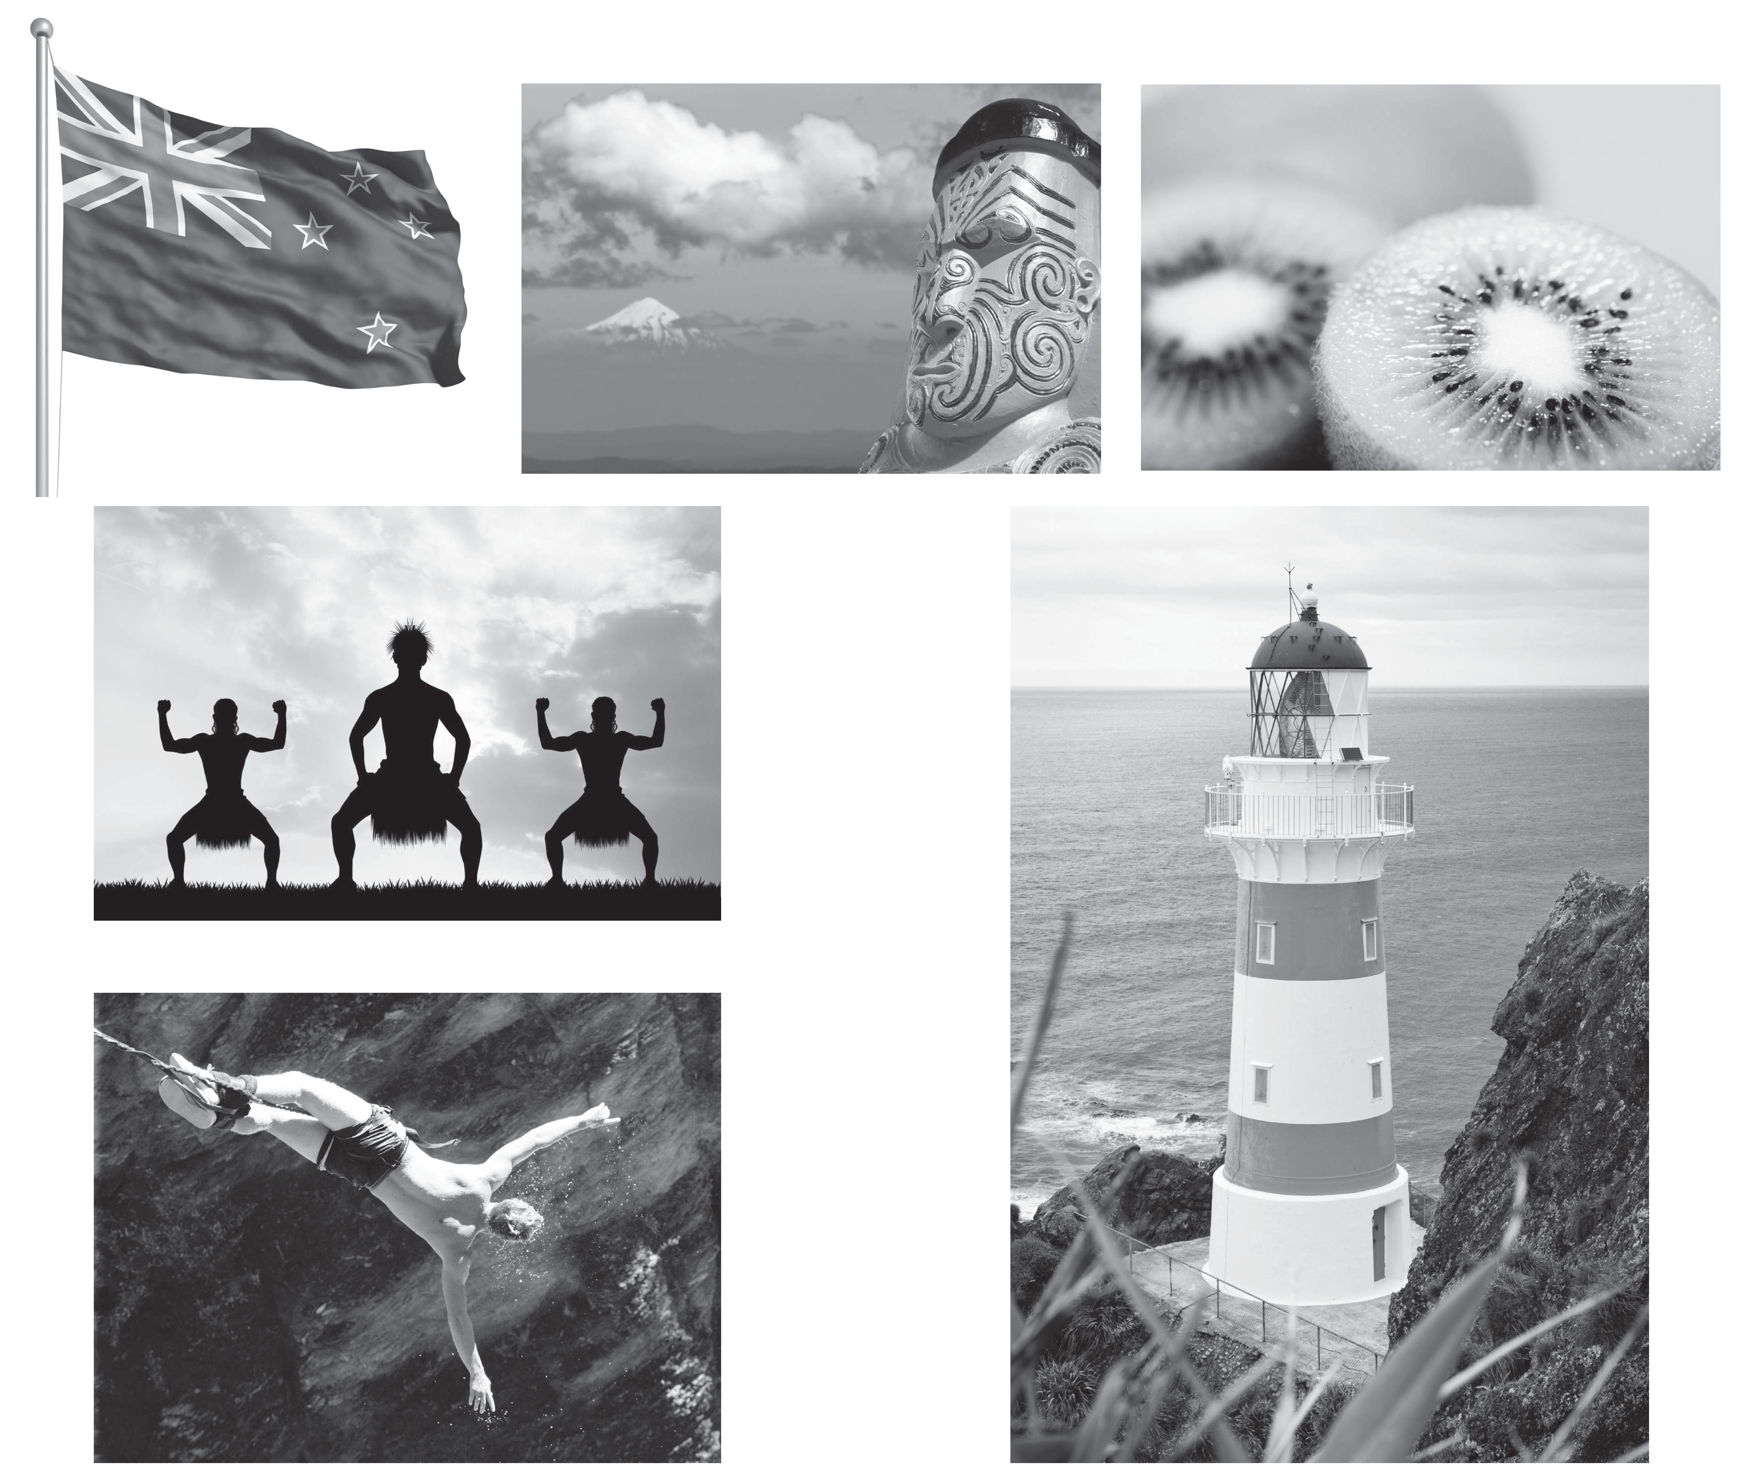
Exploring the World
Section A
Leading In
What do you know about the following pictures?

Slide 5
Exploring the World
Section A
Text A A Brief Introduction to New Zealand
Note
Geography
New Zealand is an island country in the south-western Pacific Ocean comprising two main landmasses (commonly called the North Island and the South Island), and plenty of smaller islands, most notably Stewart Island and the Chatham Islands. It is situated about 2000km southeast of Australia. The indigenous Maori named New Zealand Aotearoa, which is translated as the Land of the Long White Cloud^{[1]} . The realm of New Zealand also includes the Cook Islands and Niue, Tokelau, and the Ross Dependency. The Capital of New Zealand is Wellington while Auckland is the most populous city.
Climate
The overall climate of New Zealand is influenced by the mountains and the ocean. Although its northern reaches enjoy a temperate climate, weather can change quickly across the country, because the tropical cyclones travel through region of the South Pacific frequently. New Zealand is located in the Southern Hemisphere, so the warmest months are December, January, February; the coldest are June, July and August.

Slide 6
Exploring the World
Section A
Text A A Brief Introduction to New Zealand
Back
17世纪以前， 新西兰的居民毛利人把这片土地称为 Aotearoa， 意为 land of the long white cloud， 白云之乡[1]。

Slide 7
Exploring the World
Section A
Text A A Brief Introduction to New Zealand
Note
History
New Zealand is a recently-settled major landmass. The first settlers were Eastern Polynesians sometime between 600 and 2,000 years ago. Over the following centuries these settlers developed into a distinct culture now known as Maori. The first Europeans known to have reached New Zealand were Dutch explorer Abel Janszoon Tasman and his crew in 1642. British explorer James Cook reached New Zealand in 1769 and mapped almost the entire coastline. Following Cook, New Zealand was visited by numerous European and North American whaling, sealing and trading ships. In 1840 the Treaty of Waitangi^{[2]} was signed between the British Crown and various Maori chiefs, bringing New Zealand into the British Empire. In 1907, New Zealand became an independent Dominion and when the Statute of Westminster (1931) was ratified, it became a fully independent nation in 1947 as a member of the British Empire.
Languages
The official languages in New Zealand are English, Maori and Sign Language. English is commonly used for business, instruction and daily life.

Slide 8
Exploring the World
Section A
Text A A Brief Introduction to New Zealand
Back
1840年2月6日， 英国王室与毛利人在新西兰北岛的怀唐伊镇签订了 《怀唐伊条约》[2]， 在新西兰建立了英国的法律体系， 确认了毛利人对其土地和文化的拥有权

Slide 9
Exploring the World
Section A
Text A A Brief Introduction to New Zealand
Economy
As New Zealand is isolated geographically, its economy largely depends on international trade, especially the export of meat, fruit, vegetables, dairy and forestry products. The country has substantial hydroelectric power and sizable reserves of natural gas. Leading manufacturing sectors are food processing, metal fabrication, and wood and paper products. Tourism also plays a significant role in New Zealand’ s economy. However, New Zealand is rapidly gaining a reputation for excellence and innovation in areas ranging from film (The Lord of the Rings) and design to biotechnology and IT. Over the past 20 years the government has transformed New Zealand into a more industrialized, free market economy that can compete globally. The economy fell into recession in 2008. In line with global peers, the central bank has cut interest rates aggressively; the new government is responding with plans to raise productivity growth and development.

Slide 10
Exploring the World
Section A
Text A A Brief Introduction to New Zealand
Note
Politics
New Zealand is a parliamentary democracy^{[3]} . The formal head of state is Queen Elizabeth II, who is represented by a Governor- General^{[4]} . The Governor- General exercises the Crown’ s prerogative powers and chairs the Executive Council^{[5]} . The New Zealand Parliament has only one chamber, the House of Representatives, which usually seats 120 Members of Parliament. Elections are held every three years for Members of Parliament (the House of Representatives) and the Prime Minister (the head of the majority party). All citizens over the age of 18 have the right to vote. The highest court in New Zealand is the Supreme Court of New Zealand, established in 2004. New Zealand’ s judiciary includes the Court of Appeal; the High Court, which deals with serious criminal offences and civil matters at the trial level and with appeals from lower courts and tribunals, and subordinate courts.

Slide 11
Exploring the World
Section A
Text A A Brief Introduction to New Zealand
Back
新西兰是一个民主议会制[3]国家， 英国女王也是新西兰国家元首， 女王任命总督[4]代为行使权力。总督与内阁组成的行政会议[5]是法定的最高行政机构。内阁掌握实权， 由议会多数党组成。议会只设众议院，由普选产生， 任期3年

Slide 12
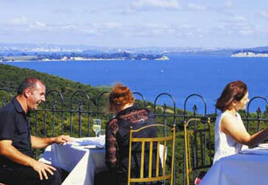
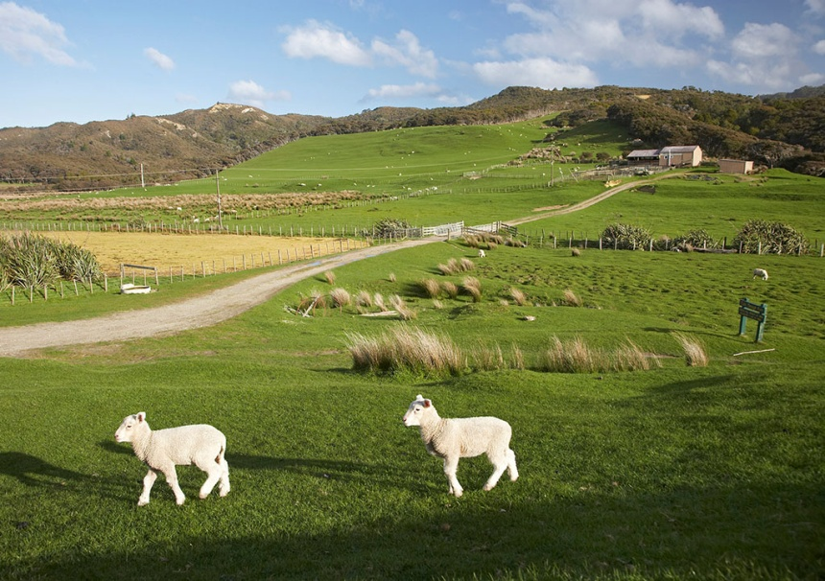
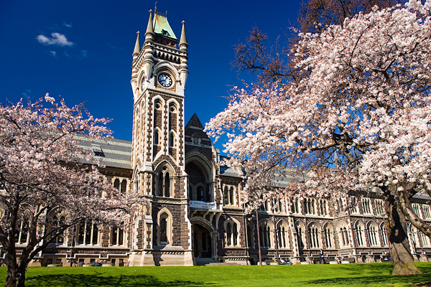
Exploring the World
Section A
Text A A Brief Introduction to New Zealand
Religion
New Zealand is a secular society and Auckland, the biggest city, is home to people from many cultures. There are centres of worship for most religions. They celebrate Christian holidays, such as Christmas and Easter, and have festivals for many other cultures and religions throughout the year.

Slide 13
Exploring the World
Section A
Vocabulary Power
notably ad. 显著地， 值得注意地
Stewart Island 斯图尔特岛 （新西兰第三大岛）
Chatham Islands 查塔姆群岛
tropical a. 热带的
cyclone n. 旋风， 气旋， 飓风
hemisphere n. (地球的) 半球
hydroelectric a. 水力发电的
innovation n. 创新， 革新

Slide 14
Exploring the World
Section A
Lesson Review
Task Search the information about New Zealand, and fill in the following form:
Capital
History
Climate
Official Languages
Economy
Government
Religion

Slide 15
Exploring the World
Section A
Text B People and Culture
New Zealanders
New Zealand has a population of around 3.65 million. People from a wide range of European countries have arrived since Captain James Cook^{[1]} discovered this continent. The Maori^{[2]} first arrived on these shores just over 1,000 years ago at the close of the last millennium. Today, the Maori have adopted Western lifestyles but have actively been encouraged to keep alive their culture, language and art. Other ethnic groups have arrived from Polynesia with Auckland now being the Polynesia capital of the South Pacific. People from China, Korea, Vietnam, etc. have also settled in New Zealand making for a diverse population mix.
Though a diverse and multicultural people, there are many qualities of most New Zealanders, including friendliness, individuality, invention and self-reliance.

Slide 16
Exploring the World
Section A
Text B People and Culture
Culture of New Zealand
The culture of New Zealand is a synthesis of home- grown and imported cultures. The country’s earliest inhabitants brought with them customs and language and developed their own Maori and Moriori cultures. British colonists in the nineteenth century brought their culture and had a dramatic effect on the inhabitants, spreading their religious traditions and the English language. Maori culture also influenced the colonists and a distinctive New Zealand European culture has evolved. More recent immigration from the Pacific, East Asia and South Asia has also added to the cultural melting-pot.
Maori Culture
The indigenous Maori people have a unique and fascinating language and culture, which plays a major role in New Zealand life. The Maori culture affects the language, the arts, and even the accents of all New Zealanders. Their place in the South Pacific and their love of the outdoors, sports, and the arts make New Zealanders and their culture unique in the world.

Slide 17
Exploring the World
Section A
Text B People and Culture
The Haka
The word “haka” simply means a dance, or a song accompanied by dance. New Zealand has grown up immersed in Haka since first encounters between Maori and early European explorers, missionaries and settlers. To most people, the Haka is a war dance. In pre- European and early contact times, the Haka was used as a part of the formal process when two parties came together.
Some perform the Haka with passion and pride. They have reclaimed the dignity and mystique attached to this traditional art form and in the process, increased its recognition as an icon of New Zealand. Today, the New Zealand Army also has its own Haka, opened and ended by female soldiers, acknowledging their special place in the armed forces. The Haka has become a unique form of national expression.
Maori Protocol
Being a tribal Polynesian people, Maori have a unique protocol — Marae Kawa, which describes a formal procedure which occurs on a meeting place. Kawa can differ with each tribe.

Slide 18
Exploring the World
Section A
Vocabulary Power
millennium n. 一千年， 千周年纪念
individuality n. 个性， 独立存在
synthesis n. 合成， 综合
evolve v. 进展， 进化
immerse v. 浸， 陷入
mystique n. 神秘

Slide 19
Exploring the World
Section A
Notes
[1] Captain James Cook： 詹姆斯·库克 （1728~1779） ， 英国探险家、 航海家， 曾三度远征太平洋， 并探索了太平洋沿岸的海岸线。据记载， 南半球的新西兰、 澳大利亚最早是由詹姆斯·库克发现的。今日新西兰北岛和南岛间的海峡，就以他的名字命名为库克海峡。
[2] Maori： 毛利人， 新西兰的少数民族， 属蒙古人种和澳大利亚人种的混合类型， 信仰多神， 崇拜领袖， 有祭司和巫师， 禁忌甚多。他们约于一千年前由太平洋中部迁徙至新西兰， 并定居。今天， 生活于城市的毛利人， 依然继承了毛利的传统文化。

Slide 20
Exploring the World
Section A
Surfing the Internet
Task Search on the Internet for more information about Maori Culture and discuss how to communicate with the local people.

Slide 21
Broadening My Horizon
Section B
Text A Tertiary Education in New Zealand
New Zealand is well known as a provider of quality education. It offers a safe learning environment which provides excellent study opportunities and support services for international students. Courses are available for academic, professional and vocational studies at universities, polytechnics, colleges of education, secondary schools and private training establishments.
The term “tertiary education” in New Zealand is used to describe all aspects of post-school education and training. There are currently 36 public tertiary education institutions, including 8 universities, 21 institutes of technology and polytechnics, 4 colleges of education and 3 wānanga. There are also 46 industry training organisations, and approximately 895 private training establishments, which include private English language schools, registered by the New Zealand Qualifications Authority.
Branches of Tertiary Education in New Zealand
Colleges of Education (Teachers’ Colleges) Polytechnics
Polytechnics in New Zealand provide education and training in a broad range of industry and occupation based vocational studies. Many offer undergraduate degree programs.

Slide 22
Broadening My Horizon
Section B
Text A Tertiary Education in New Zealand
Private Training Establishments
Private Training Establishments provide training often not available in the public sector. They also provide training to special need groups or in time frames that support different learner needs. Private Trainers provide domestic learners and international learners with courses in Computing, Hospitality, Business, Health Care and Contact Centre.
Wānanga
In New Zealand, a wānanga is a type of publicly owned tertiary institution that provides education in a Maori cultural context. Universities Typically, a Bachelor’ s degree will take three years, and a further year of study will lead to an Honours degree. Not every degree follows this 3+1 pattern: there are some four-year degrees (which may or may not be awarded with Honours), and some specialist Bachelor’s degrees which take longer to complete.

Slide 23
Broadening My Horizon
Section B
Text A Tertiary Education in New Zealand
A Bachelor’ s degree may be followed by a Master’ s degree. A candidate who does not hold an Honours degree may be awarded a Master’ s degree with honours: such a degree usually involves two years’study, compared with one year for a Master’ s degree for a candidate with an Honours degree. A candidate who has either a Master’ s degree or a Bachelor’s degree with Honours may proceed to a doctoral degree.
Entry to most universities is “open” , that is to say that one only needs to meet the minimum requirements in the school-leaving examinations.
Admission Requirements
Both TOEFL and IELTS are used extensively in New Zealand to determine entry to higher learning.
Colleges
The minimum English language standard required for entry to the Diploma of Education course is a score of 6.5 on IELTS. For applicants over 20, no formal secondary school qualifications are required, but evidence of relevant experience or capacity to engage in tertiary study is required.

Slide 24
Broadening My Horizon
Section B
Text A Tertiary Education in New Zealand
Polytechnics
Qualifications are designed to allow students to enter and exit at different levels appropriate to their academic level and English language ability. Private Training Establishments
Each institute specifies the acceptable level of English required, as in an IELTS or TOEFL score, for the individual programs. Details regarding the entrance criteria should be taken from the institutes the student is interested in pursuing the program.
Universities
All students must be fluent in the English language if they are to succeed at a university in New Zealand. The universities have specified minimum levels of competence (e.g. 6.0 in IELTS or 550 in TOEFL for most undergraduate degrees).

Slide 25
Broadening My Horizon
Section B
Text A Tertiary Education in New Zealand
Credit Transfer
Credit transfer is the application of credits gained from another qualification at another educational institution. Credit transfer recognises previous study at another institution and gives students points toward the degree they are studying in New Zealand.
Students who have more than the minimum entrance requirements for undergraduate degrees can apply for credit transfer. If they are given credit transfer, they do not have to do as many points for their degree, as points are awarded to them based on previous study.
International Comparability of Tertiary Qualifications
Bachelor’ s degrees from New Zealand tertiary education providers are comparable overall to:
· British Bachelor’ s (Ordinary) degrees
· Australian Bachelor’ s degrees
New Zealand Bachelor’s degrees are recognised for enrollment in postgraduate programmes at universities throughout the world, subject to the normal grade and subject-specialisation requirements.

Slide 26
Broadening My Horizon
Section B
Vocabulary Power
frame n. 框， 结构， 骨架
minimum a. 最低的

Slide 27
Broadening My Horizon
Section B
Notes
Honours degree： 荣誉学士学位。学生大学期间成绩B+以上， 大学会邀请他们读一些深入研究课程， 可以抵消硕士课程第一年， 毕业后就是荣誉学士。

Slide 28
Broadening My Horizon
Section B
Surfing the Internet
Task Search online for more information of tertiary education in New Zealand and discuss how to apply for Bachelor’s degrees in New Zealand.

Slide 29
Broadening My Horizon
Section B
Text B Natural Attractions
New Zealand’ s green and friendly isles, situated in the vast South Pacific Ocean, are ranked among the world’s most popular holiday destinations.
Abel Tasman Coast
Abel Tasman National Park is a national park located at the north end of the South Island of New Zealand. The coastal fringe of this park often has the look and feel of a tropical paradise, enjoying a record 2,500 sunshine hours each year. The exquisite coastal track is one of New Zealand’ s Great Walks, traverses lush forest, magnificent tidal flats and beaches.
Bay of Islands
Named by the great navigator, Captain James Cook, in 1769, the Bay of Islands is a stunningly beautiful length of sand and rock coastline, which circles a sea pierced by 150 islands. And another specialty of the bay is swimming with dolphins.

Slide 30
Broadening My Horizon
Section B
Text B Natural Attractions
Waitomo Caves
The caves are one of New Zealand’s most impressive natural wonders. The Waitomo caves have huge chambers containing delicate stalactite and stalagmite formations. The entire region is honeycombed with limestone caves, subterranean streams anddeep “tomos.”
The Franz Josef Glacier
The Franz Josef Glacier is just like a wonderland of pristine whiteness because of its ice pinnacles, blue crevasses, deep caves and towering seracs. The glorious crispness and purity of the jumbled icefall is extremely astounding.

Slide 31
Broadening My Horizon
Section B
Text B Natural Attractions
Lake Taupo
Lake Taupo, which lies in central North Island, is the country’ s largest lake, and a mecca for visitors travelling between Auckland and Wellington. The heart- shaped lake is the crater of an ancient volcano that last erupted in 186AD, blocking out the sun with a red dust cloud recorded in both Rome and China. Today the lake and township occupy a magnificent setting with a backdrop of towering active volcanoes in the Tongariro National Park.
Mount Cook
Mount Cook was named for Captain James Cook in 1841. Mt Cook, 3,755 metres, is the highest point in Australasia. Mt Cook soars above the Tasman River bed and dominates its surroundings. The mountain forms the centrepiece of a giant canvas of snow- capped mountains, glaciers, rivers and lakes.

Slide 32
Broadening My Horizon
Section B
Vocabulary Power
fringe n. 边缘， 边界
exquisite a. 精致的， 优美的
traverse v. 横越， 横贯
stunningly ad. 惊人地
pierce v. 刺穿， 穿透， 穿(孔， 洞)
stalactite n. 钟乳石
stalagmite n. 石笋
crevasse n. 裂缝， 破口
serac n. 冰塔

Slide 33
Broadening My Horizon
Section B
Notes
mecca: 麦加(Mecca， 位于沙特阿拉伯西部, 穆罕默德诞生地, 伊斯兰教第一圣地)， 这里指 “众人向往的地方” 。

Slide 34
Broadening My Horizon
Section B
My Project
Task Search for more natural attractions in New Zealand and make a presentation to the whole class.

Slide 35
Reading for Pleasure
Section C
Text A Food Culture
New Zealand Cuisine
New Zealand’ s cuisine has been described as Pacific Rim, drawing inspiration from Europe, Asia and Polynesia. This blend of influences has created a mouth-watering range of flavours and food in cafés and restaurants nationwide. For dishes that have a distinctly New Zealand style, there’ s lamb, pork and cervena (venison), salmon, crayfish (lobster), bluff oysters, paua (abalone), mussels, scallops, pipis and tuatua (both are types of New Zealand shellfish), kumara (sweet potato), kiwifruit and pavlova, the national dessert.
Wine and Food Festival
Wine and food festivals are held annually in Auckland^{[1]} , Hawke’ s Bay, Nelson, Canterbury and Queenstown. These unique festivals bring a range of different wines and food together, highlighting how well wine can complement all sorts of different New Zealand cuisine and food.

Slide 36
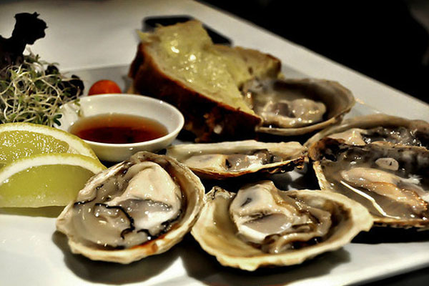
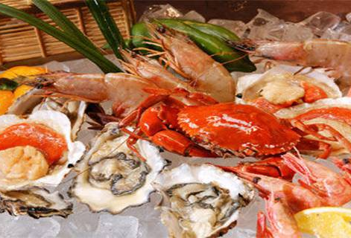
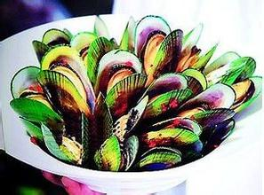
Reading for Pleasure
Section C
Text A Food Culture
Wildfood Festival
Held every year in Hokitika^{[2]} , this festival is all about celebrating New Zealand’ s wild food from New Zealand. People from New Zealand and all over the world come to Hokitika every year to join in on this celebration of food. Stalls show off all types of odd but interesting food of New Zealand. Everything from sheep’ s eyes to bug larvae, wild highland beef, curried Hokitikka, pesto ice-cream, mountain merino and venison tongue are all on the list of things.

Slide 37
Reading for Pleasure
Section C
Vocabulary Power
rim n. 边， 边缘
oyster n. 牡蛎
mussel n. 淡菜， 贻贝
odd a. 古怪的
bug n. 小虫， 臭虫
larvae n. 幼虫
merino n. 美利奴羊

Slide 38
Reading for Pleasure
Section C
Notes
[1] Auckland： 奥克兰， 是新西兰第一大城市， 全国工业、 商业和经济贸易中心， 集中全国近四分之一的人口。奥克兰位于新西兰北岛的奥克兰区， 它拥有50多个小岛， 一半内陆城镇、 一半海边城镇的特点使之成为一个多元化的水世界。
[2] Hokitika： 霍基蒂卡， 新西兰南岛西海岸的一个乡镇。

Slide 39
Reading for Pleasure
Section C
Surfing the Internet
Task Search on the Internet for distinctive food in New Zealand and design a menu.

Slide 40
Reading for Pleasure
Section C
Text B Bungy Jump
New Zealand was brought to the forefront of adventure sports when in 1888 AJ Hackett^{[1]} opened the first commercial bungy jump from the 43-metre Kawarau Bridge over the Kawarau River^{[2]}. New Zealand, otherwise is known as “Bungyland” . Today, it has become a popular extreme sport all over the world.
Sky Tower Sky Jump
The Auckland Sky Tower Sky Jump is a cable-controlled base jump, where participants can choose to go down feet first or glide down head first like Superman. Participants wear a special suit with a full body harness attached to a wire cable and a descender unit. As they fall the cable drum feeds out wire behind them at a controlled speed. They fall at about 60 kph and gradually decelerate as the ground approaches and finally touch down on the lower platform at a safe landing speed. The fall lasts around 20 seconds and provides an unbeatable ground rush.

Slide 41
Reading for Pleasure
Section C
Text B Bungy Jump
Auckland Harbour Bridge Bungy
The Auckland Harbour Bridge Bungy was officially opened in April 2003. A state-of-the-art jump pod has been installed under the road deck of the bridge in the main navigation span. Jumpers leap 40 metres from the jump pod to sea level and rebound into the air several times, often accompanied by screams of fear or exhilaration. They are then winched back up by a patented retrieval system. A range of splash options are available from a simple hand touch to a head-and-shoulders dunking or a total body immersion.
Thrillseeker’ s Canyon Bungy
Located at the Waiau River Bridge near Hanmer Springs, Thrillseeker’ s Canyon Bungy is an ideal location for first-time jumpers. At 35 metres it is the lowest New Zealand bungy site. The jump platform is built on the side of the 135-year-old Waiau Ferry Bridge. The total time for preparation and the jump is around 15 minutes. Certificates are issued to jumpers and souvenir photos and T-shirts are available.

Slide 42
Reading for Pleasure
Section C
Vocabulary Power
extreme sport 极限运动
descender n. 下降者， 下降物
navigation n. 航行， 航海
exhilaration n. 高兴， 兴奋
retrieval n. 取回， 恢复
souvenir n. 纪念品

Slide 43
Reading for Pleasure
Section C
Notes
[1] AJ Hackett: 阿伦·约翰·哈克特， 新西兰人， 被称为 “蹦极之父” 。他创制了玩“蹦极跳” 时使用的乳胶橡筋绳索， 以束着双足把整个人倒吊空中， 时而左右摇摆、 时而上下动弹。
[2] Kawarau River:卡瓦罗河， 位于新西兰奥塔戈的西北部。

Slide 44
Reading for Pleasure
Section C
Surfing the Internet
Task Search on the Internet and make a list of the popular sports in Commonwealth countries.

